Slide 1
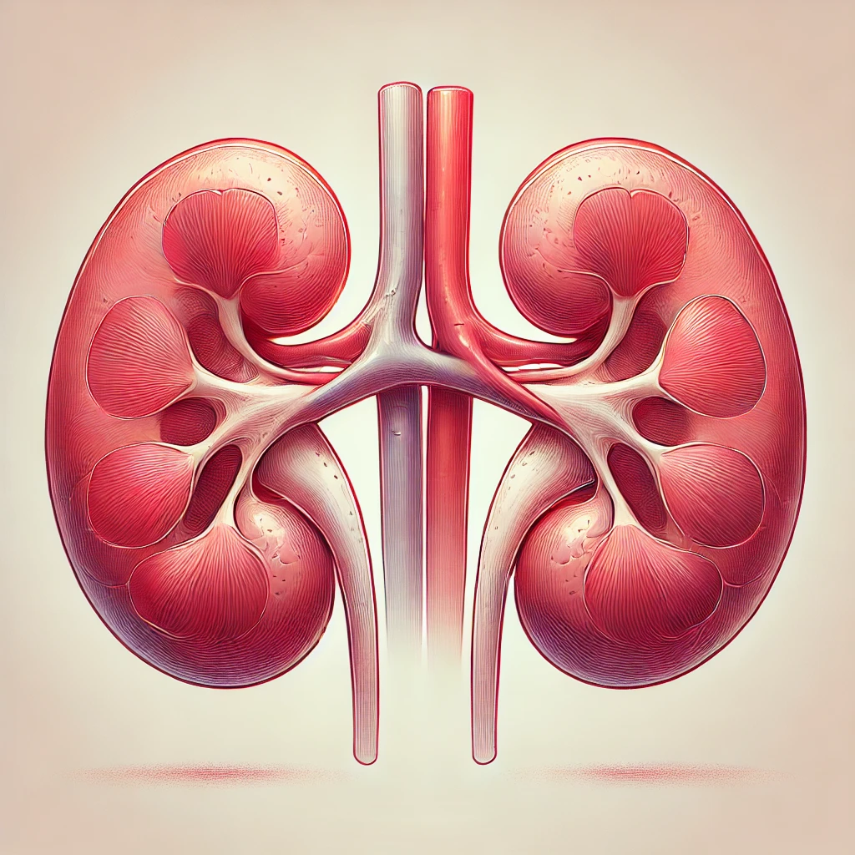
Chronic Kidney Disease Prediction
2nd Mini Project
Ton Nattapan

Slide 2
Why this study?
Personal experience with the potential of Chronic Kidney Disease (CKD) and a friend who currently needs a kidney transplant.
**CKD contributed to around 10% of all deaths in Australia in recent years.
**The number of people requiring dialysis or kidney transplants continues to rise.
Early identification of kidney disease allows for timely intervention, which can slow or halt the progression of the disease.
Early treatment can help prevent complications.
So, is it possible to build an accurate prediction model based on pathology laboratory test results for early identification of CKD?
** Source: The Australian Institute of Health and Welfare (AIHW)

Slide 3
About the dataset
Source: UCI Machine Learning Repository , unable to access Australia public dataset
Class: CKD or NOT CKD
Features: 24 features, age, blood pressure, specific gravity, albumin, sugar, red blood cells, pus cell, pus cell clumps, bacteria, blood glucose random, blood urea, serum creatinine, sodium, potassium, hemoglobin, packed cell volume, white blood cell count, red blood cell count, hypertension, diabetes mellitus, coronary artery disease, appetite, pedal edema, anemia.

Slide 4
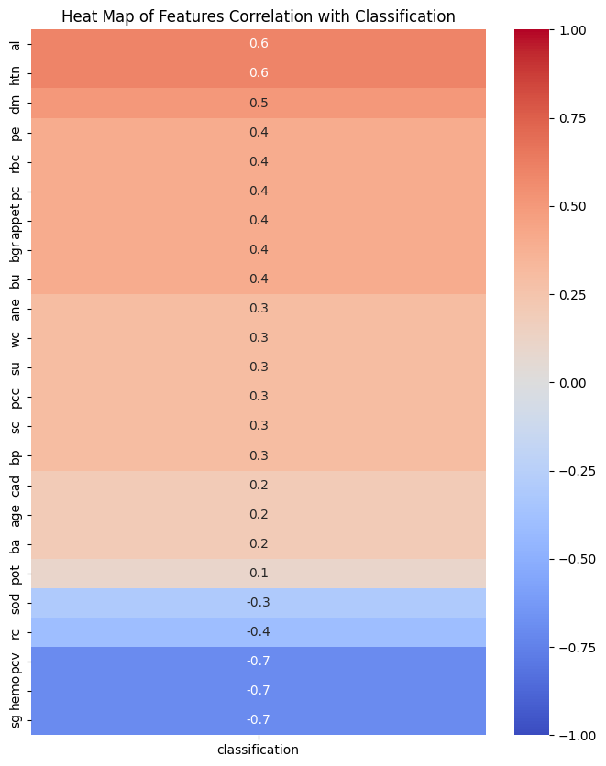
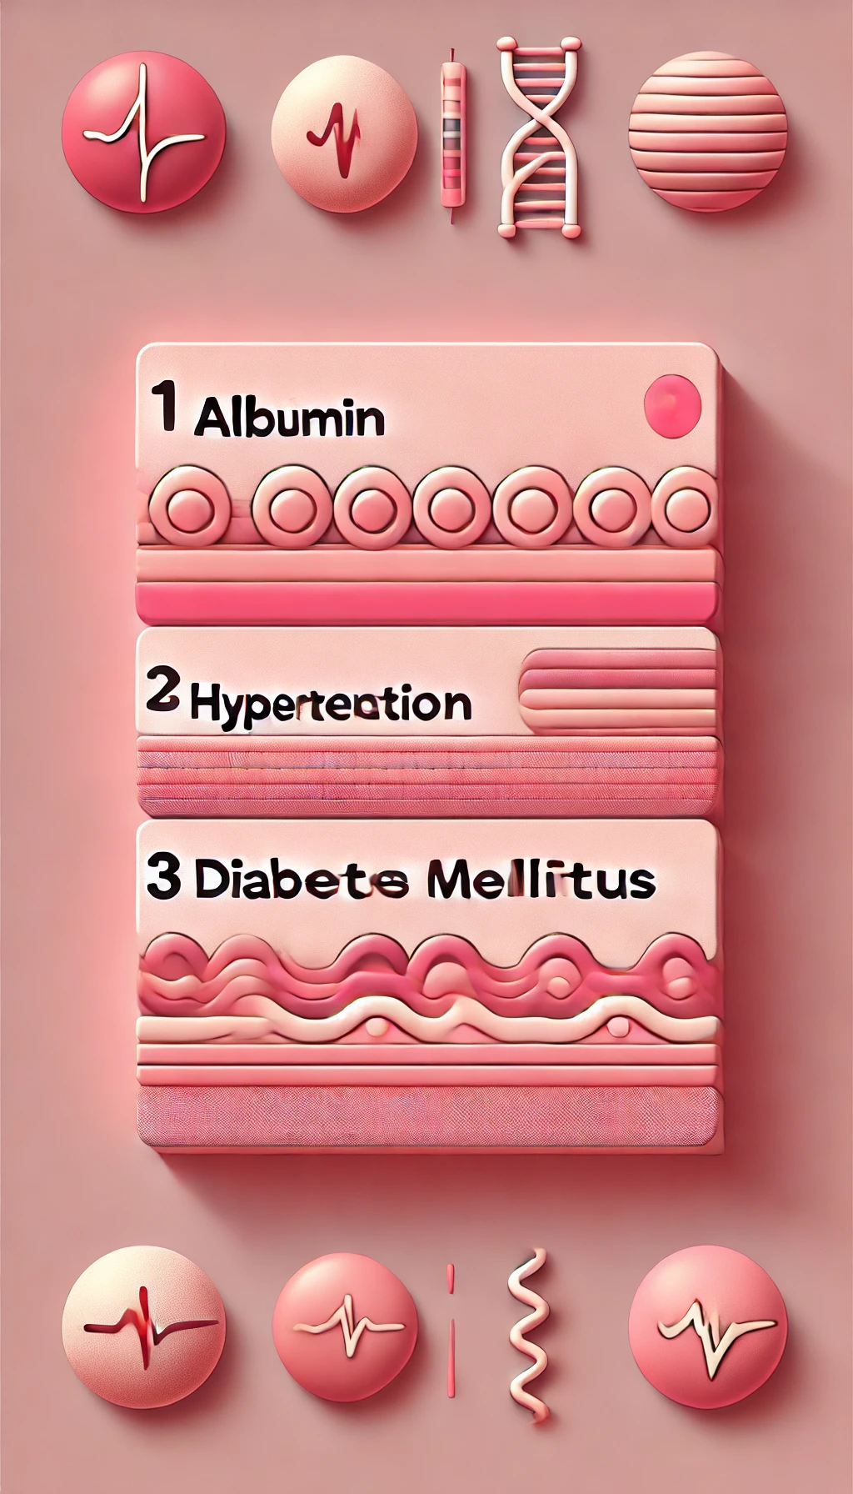
EDA – Finding Correlations

Slide 5
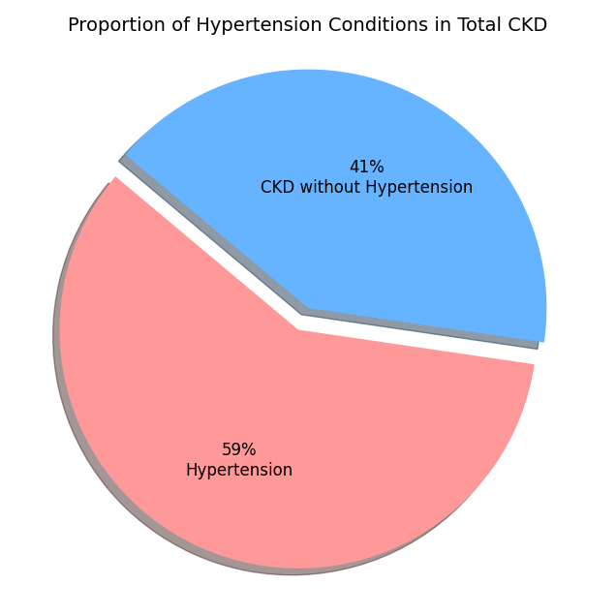
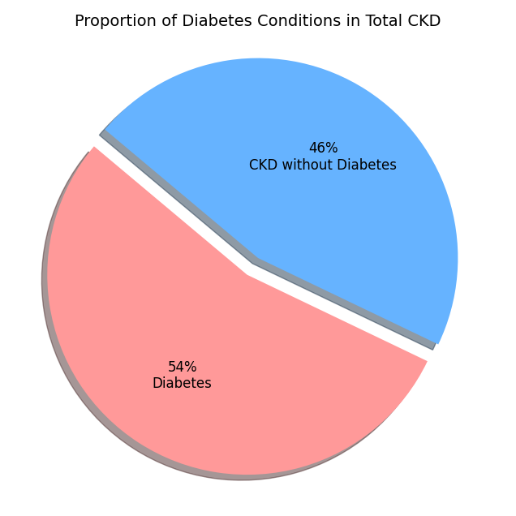
EDA – Proportion of Hypertension and Diabetes in CKD
Having hypertension or diabetes significantly increases the likelihood of developing CKD
Is there a correlation between hypertension and diabetes?

Slide 6
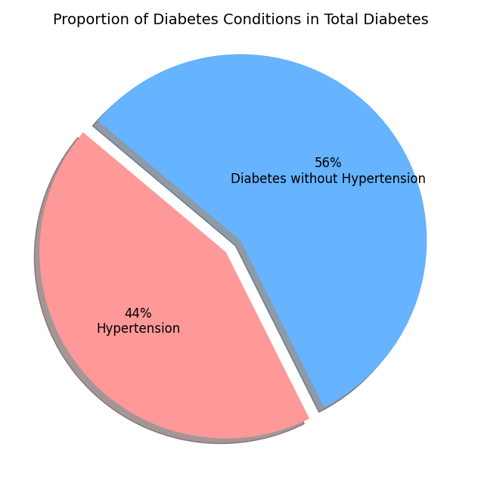
EDA – Correlation of hypertension and diabetes
Individuals with diabetes, significant portion (44%) also having hypertension
Correlation coefficient between diabetes and hypertension is 0.6, implies that having diabetes increases likelihood of developing hypertension

Slide 7
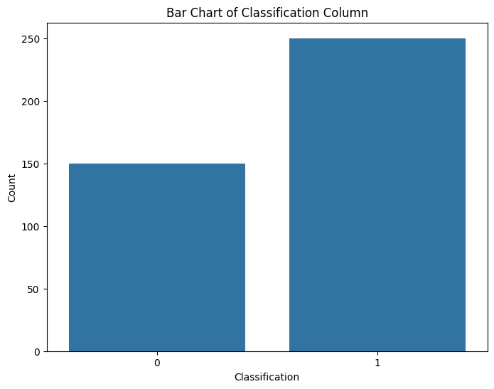
EDA – Check class balance
Class imbalanced in data
Significant higher ‘CKD’ than ‘NOT CKD’ in dataset.
Data will be stratified

Slide 8
Prediction – Ensemble Stacking
2. Split data – stratified (imbalanced in class)
3. Setup GridSearch for hypermeters
4. Fit train data and GridSearch into LR, KNN, SVC, NB
5. Ensemble best models
1. Standardize values in numeric features

Slide 9
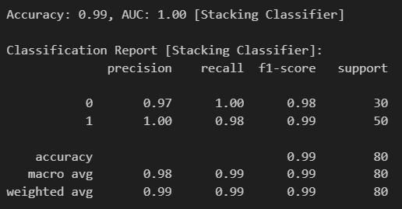
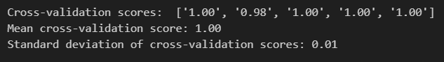
Prediction - Results and interpretation
High accuracy 0.99
Perfect AUC of 1.00
Stacking Classifier appears to be an excellent choice
High mean accuracy 1.00
Low standard deviation 0.01
Performing consistently well across different subsets

Slide 10
Summary of the study
Chronic Kidney Disease Prediction: Chronic Kidney Disease can be accurately predicted based on pathology laboratory tests.
EDA Discoveries: Hypertension, Diabetes, and Chronic Kidney Disease are highly correlated. Having one of these conditions significantly increases the likelihood of developing another.
Population Variability: Prediction results may vary across different population groups.
Importance of Early Identification: Chronic Kidney Disease often does not show symptoms until stage 3. Early identification is crucial for slowing or halting the progression of the disease. Regular pathology laboratory tests are highly effective and accurate for disease prediction.

Slide 11
Q&A

